Slide 1


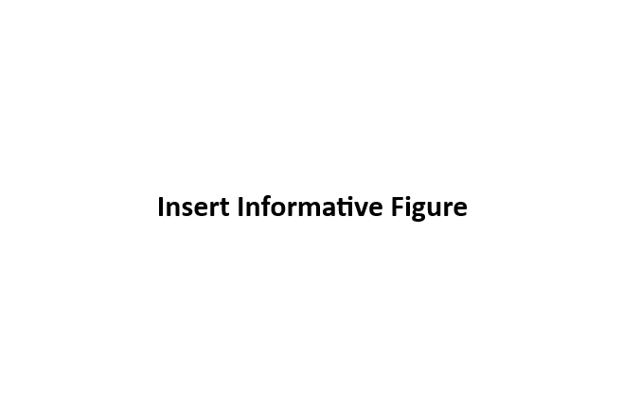
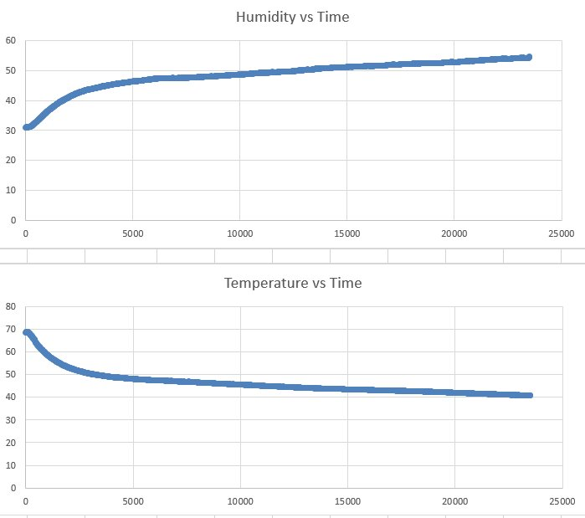
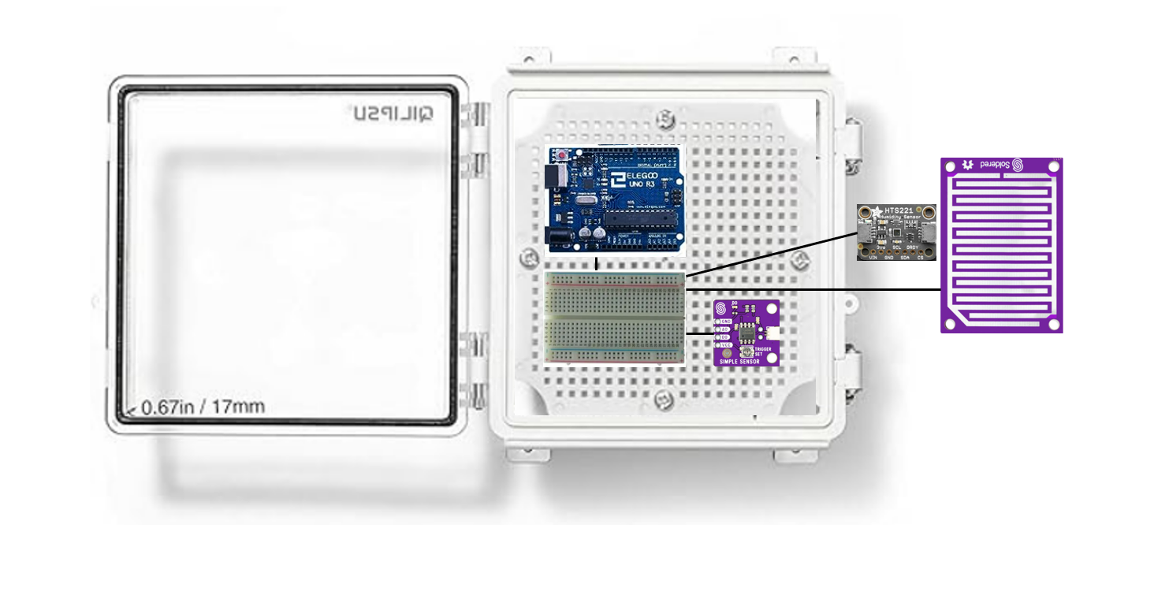
NYSDEC Data Acquisition Unit Matthew Diehl, Anthony Testa, Hemel Debnath, Bilal Mahmood Department of Electrical & Computer Engineering, University at Albany
Problem Statement
System Design
System Design
Climate change affects all regions, causing rising sea levels, global temperatures, and various weather anomalies. In New York State, diverse microclimates—mountains, lakes, marshlands, fields, forests, and urban areas—experience these changes differently. The goal is to create a weather monitoring system to measure humidity, temperature, and precipitation data in these microclimates. This data will help the NYSDEC address potential negative effects of climate change in the state.
Key System Features
To satisfy system requirements, we incorporated the following design specifications:
Adafruit HTS221 Sensor: Collects ambient temperature and humidity data and uploads to Arduino
Soldered Electronics: Collects precipitation data.
Arduino Uno R3: Interfaces collecting and processing of data
Enclosure: Weatherproof housing for components
System Requirements
Ability to Collect Weather Data: The system should be able to collect data on ambient temperature, humidity, and precipitation as a means of measuring the impact of climate change on microclimates in New York. According to the Environmental Protection Agency, climate change in the U.S. has been defined by a rise in average temperature and 0.2 inch per decade increase in precipitation across the 48 states on the U.S. mainland.
Accuracy of Collected Data: Data collected from the weather monitoring system should be accurate and undergo error analysis to ensure accuracy and precision. Here, “accurate” and “precise” data will include any data collected through the system which has a maximum percent error of 5 – 10% from corresponding data collected for that hour through a local or national weather station.
Speed and Efficiency: The system should be able to perform data acquisition, processing, and transmission simultaneously without significant delays in time. An acceptable latency time for acquisition and processing of the data starting from data collection to data storage in an Excel file should be no more than the maximum latency time of the Arduino Uno (i.e, around 5.1 milliseconds).
Durability to Weather Extremities: Since the weather monitoring system will be implemented throughout New York State, it is important to consider the range of extreme weather conditions such as blizzards, snowstorms, and thunderstorms that could pose a threat to any outdoor components of the system.
Figure 1: Temperature Data Collected at an Hourly Basis
Figure 3: Physical Design of Data Acquisition Unit
Bill of Materials
Part | Purpose | Cost
Adafruit HTS221 Sensor | Sensor that will acquire temperature and humidity data | $9.95
Arduino Uno R3 Board with USB Cable | Used to process data and upload data to an Excel file for storage | $29.95
Half Size Breadboard | Holds connections of sensors with microcontroller | $7.99
Soldered Electronics 333044 | Precipitation sensor used to detect and identify whether there is precipitation in the environment. | $7.39
QILIPSU Weatherproof Enclosure | Heavy duty plastic enclosure used to house data acquisition unit | $18.88
TOTAL | TOTAL | $74.16
Bill of Materials
Figure 2: Precipitation Data Collected at an Hourly Basis
Project Partners

